Slide 1
Chapter 25
America Moves to the City (1865 – 1900)

Slide 2
The Growth of Cities
1st sky-scraper built in Chicago in 1885 (ten-story bldg.)
Courtesy of the Bessemer process (Carnegie, Ch. 24)
Aspects of cities
Electric trolleys
Residential neighborhoods segregated by race
Industrial jobs drew people from the country
Cities gave women economic opportunity and independence
Social workers, secretaries, stenographers, switchboard operators, etc.

Slide 3
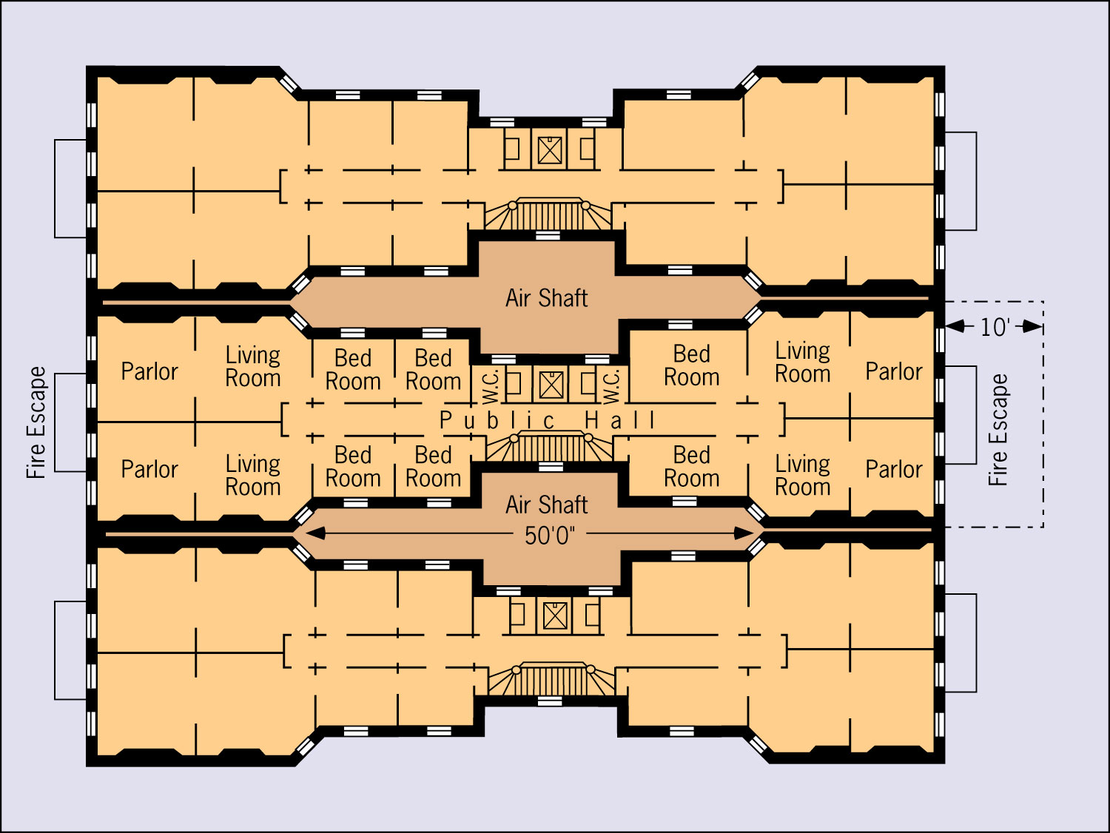

Rural “general stores” replaced by Sears and Montgomery Ward mail order catalogues
What stores are replacing “mom and pop” stores today?
Issues in city life
Waste disposal
Criminals flourished
Uncollected garbage
Population explosion
Tenement housing

Slide 4
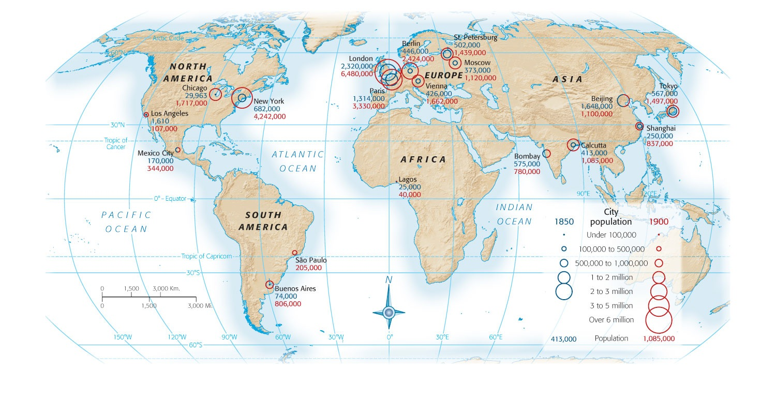
The New Immigration
Old Immigration: Before 1880
Mostly British and Western European
Usually Protestant (some German and Irish Catholics)
High rate of literacy
Adjusted to American life pretty easily
New Immigration (1880-1920)
Southern and Eastern Europe (Italy, Croatia, Greece, etc.)
Mostly illiterate, poor, and likely to work in cities
Tensions mount between New and Old

Slide 5
Reasons for Immigration
Europe’s population increasing at drastic rates, many unemployed people
Why did they move here?
“American letters”
No military conscription (draft) here
Free from institutionalized religious persecution
“Birds of Passage” – work, send $ back home, and return
Many Jews were forced to leave
Tailors and shopkeepers

Slide 6
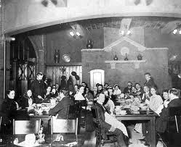
Reactions to the New Immigration
Mostly ignored, except by political bosses.
Rewarded with jobs
Tammany Hall
Social Crusaders attempted to improve the "shame of the cities"
Walter Rauschenbusch and Washington Gladden
Insisted that churches tackle social issues
Jane Addams
**Hull House** (Settlement House)
1893: Illinois passes anti-sweatshop law
Most working women were single. Why?
Employment for working women and wives was taboo

Slide 7
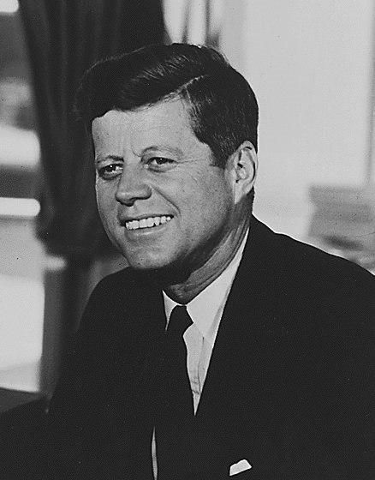
Examples of Nativism
Most New immigrants came for same reasons as Old; to escape poverty
More concerns about New immigrants:
High birthrate
Anglo-Saxons could be outvoted and outnumbered
Radical ideas such as socialism, communism, anarchism, etc.
Just like Know-Nothings, anti-foreign groups emerge
American Protective Association (APA) – urged voting against Catholics

Slide 8
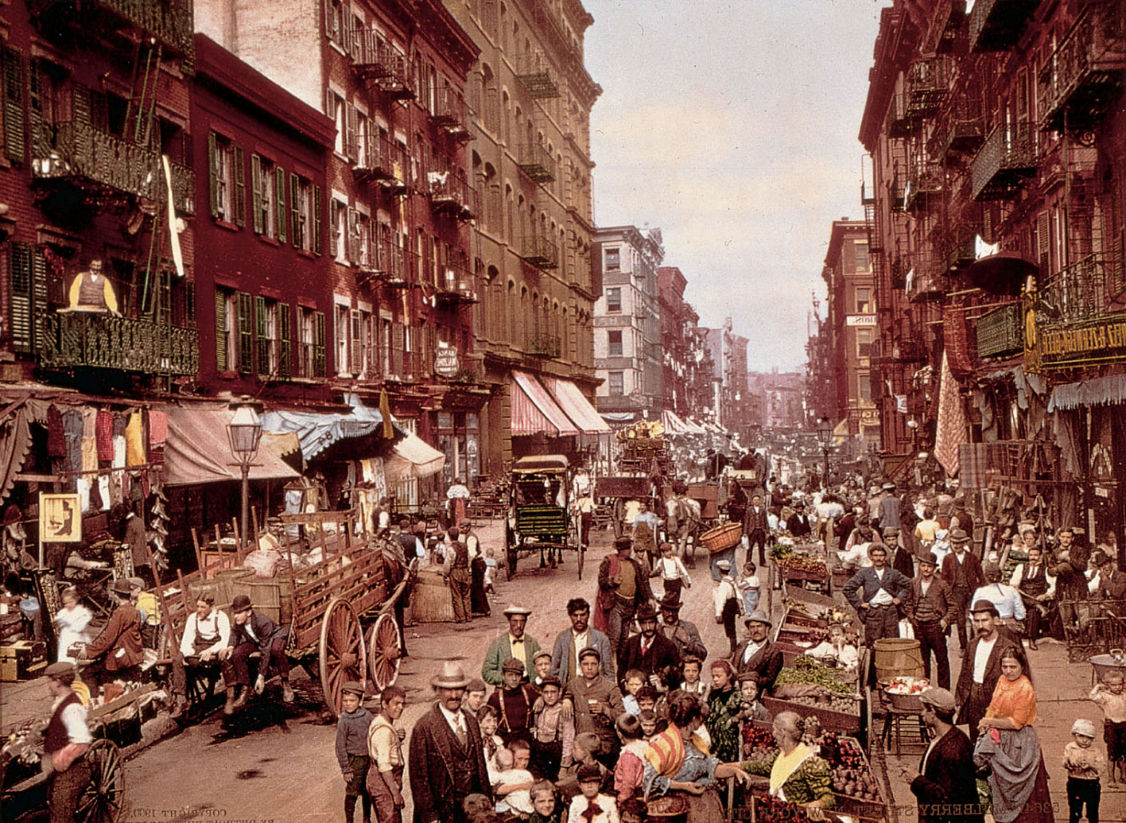
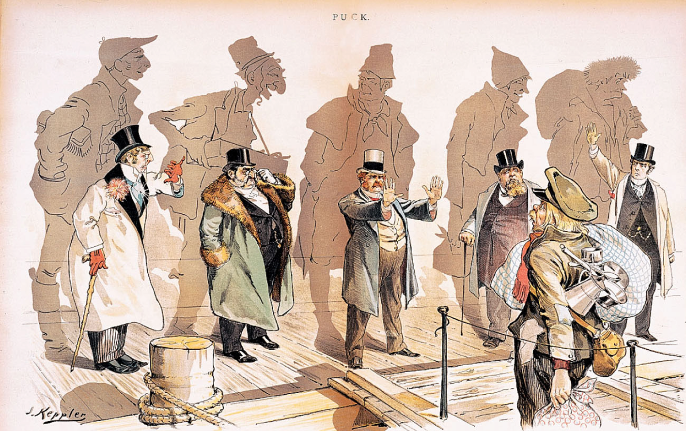
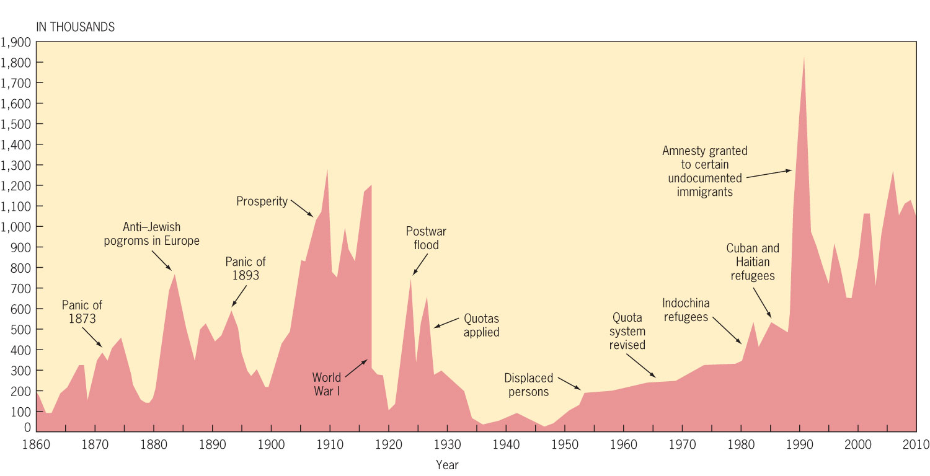
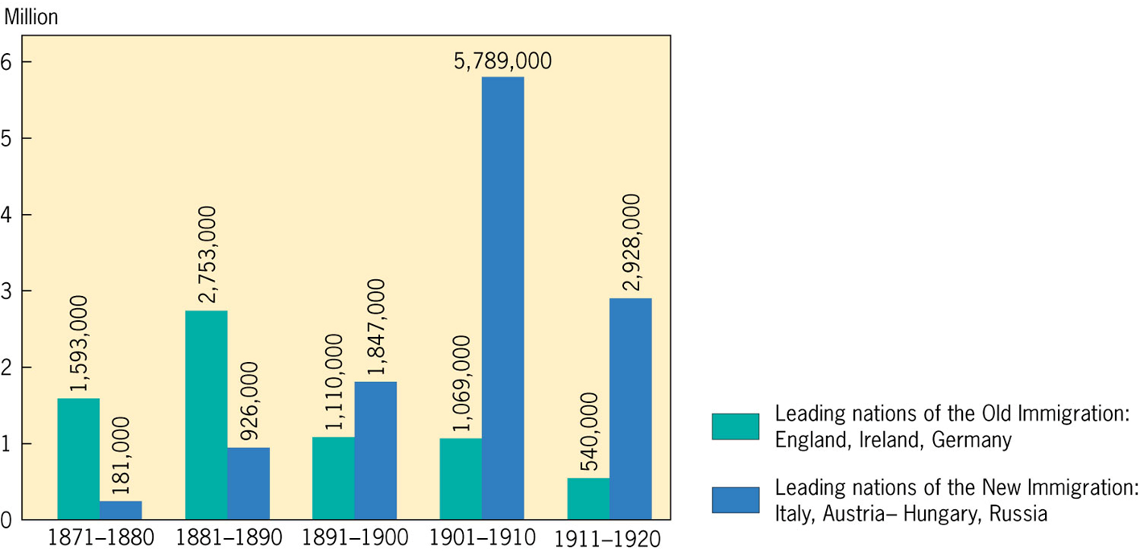
More Immigration stuff
New immigrants were used as strikebreakers
Immigrants were hard to unionize (language)
1882: Chinese Exclusion Act (Chinese not part of New immigration)
Literacy tests were proposed for immigration, but not enacted until 1917.

Slide 9
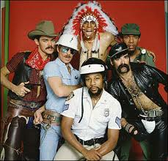
The Social Gospel
Social Gospel:
Church movement to improve conditions affecting society
YMCA YWCA were formed by churches

Slide 10
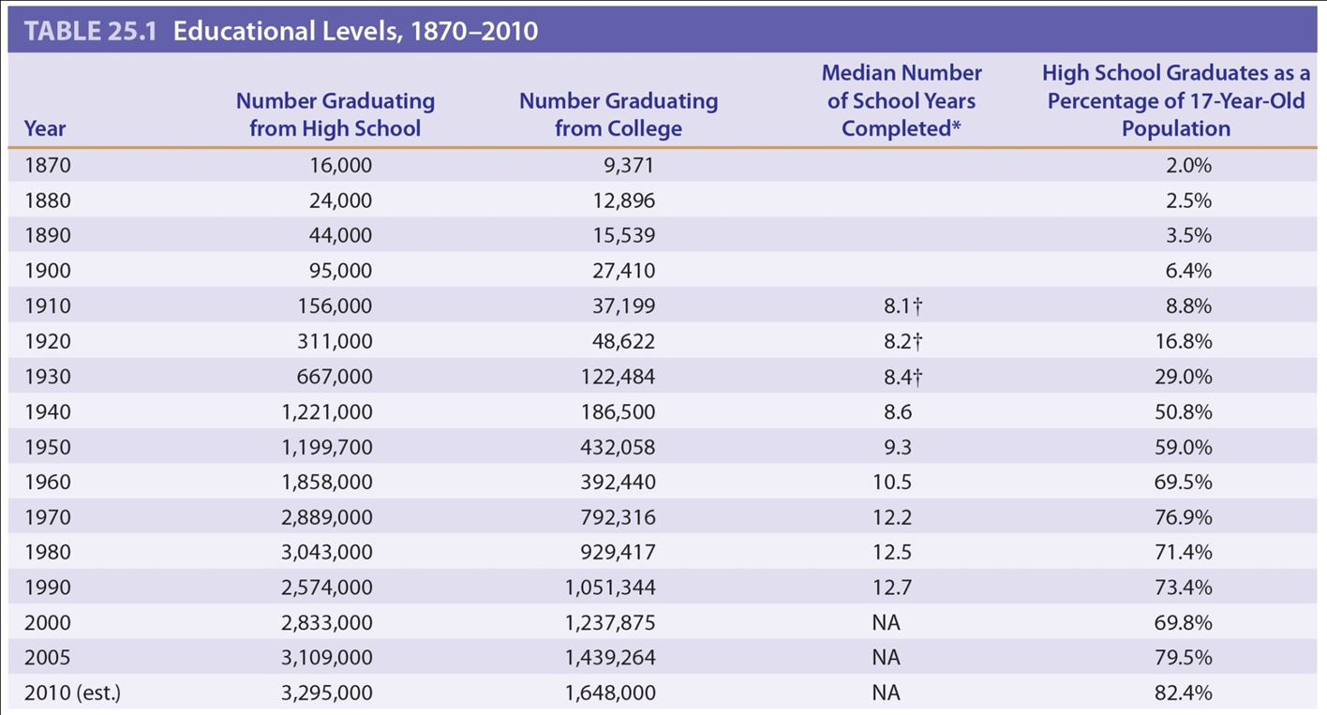
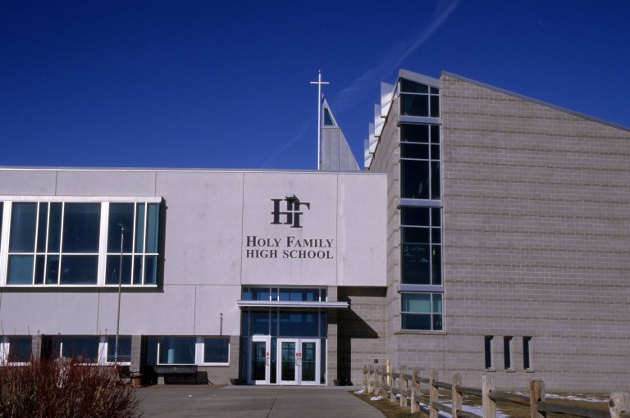
The Lust for Learning
Who helped influence and spread education?
Horace Mann
By 1900, high schools were increasing drastically
Free textbooks supported by taxpayers
Private Religious schools
Illiteracy rates dropped from 20% in 1870 to 10.7% in 1900

Slide 11
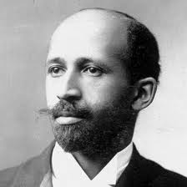
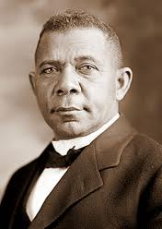
Key African Americans
Booker T.:
Ex slave, believed Blacks should be educated in trades so they could gain self-respect and economic security
Labeled “Accommodationist” – someone who seeks compromise
Called “Uncle Tom” by W.E.B. Du Bois
W.E.B.:
Ph.D. from Harvard
(“The honor I assure you, was Harvard’s)
Demanded immediate political equality for Blacks
Helped found NAACP
Differences “reflected the contrasting life experiences of southern and northern Blacks”

Slide 12
Development of New Schools
Morrill Act of 1862:
Granted public land to states for support of education
Hatch Act of 1887:
Provided federal funds for establishment of agricultural experiment stations
New colleges and Universities develop
Cornell
Johns Hopkins

Slide 13
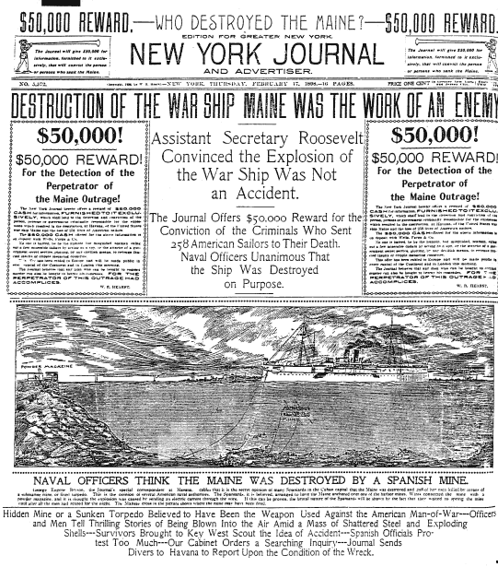

The Role of the Press
Sensationalism:
Public interested in sex, scandal, and human interest stories
Yellow Journalism:
Exaggerating/making up stories to sell newspapers
William Randolph Hearst & Joseph Pulitzer

Slide 14
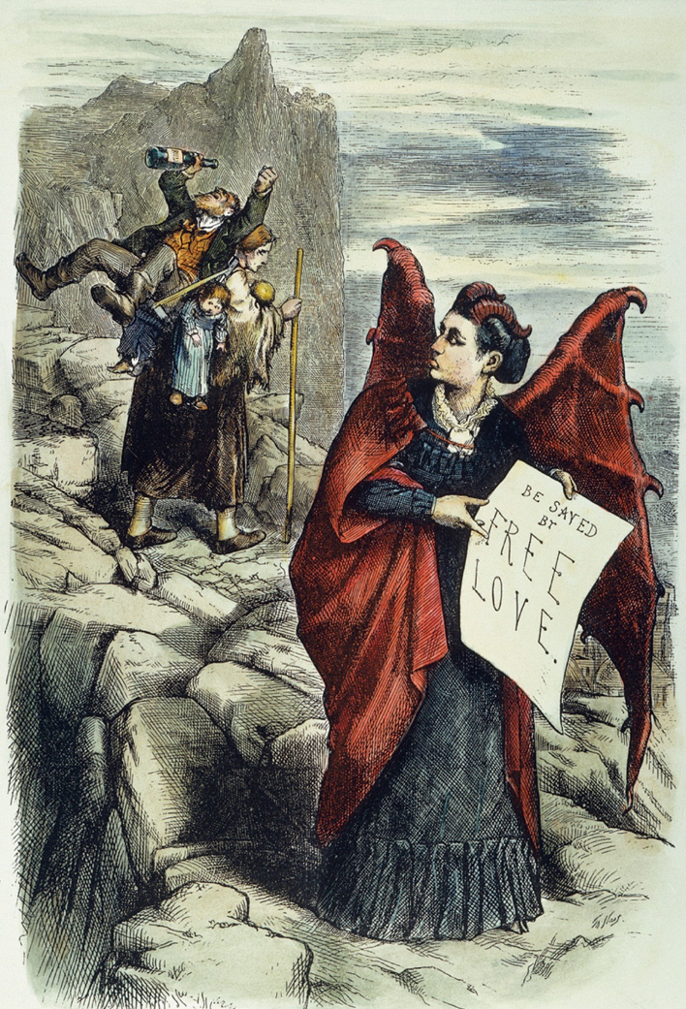
Key Books and Authors to Know
Edward Bellamy:
Looking Backward, government nationalized big business to serve interest of public
Victoria Woodhull:
Woodhull and Claflin’s Weekly, belief in free love
Anthony Comstock
Self-appointed defender of sexual purity
Together they expose battle of 19th century sexual attitudes in America

Slide 15
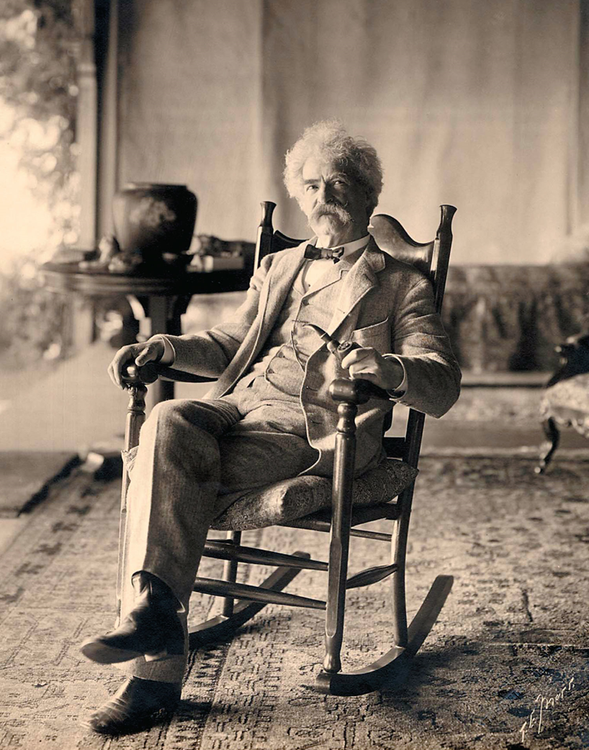

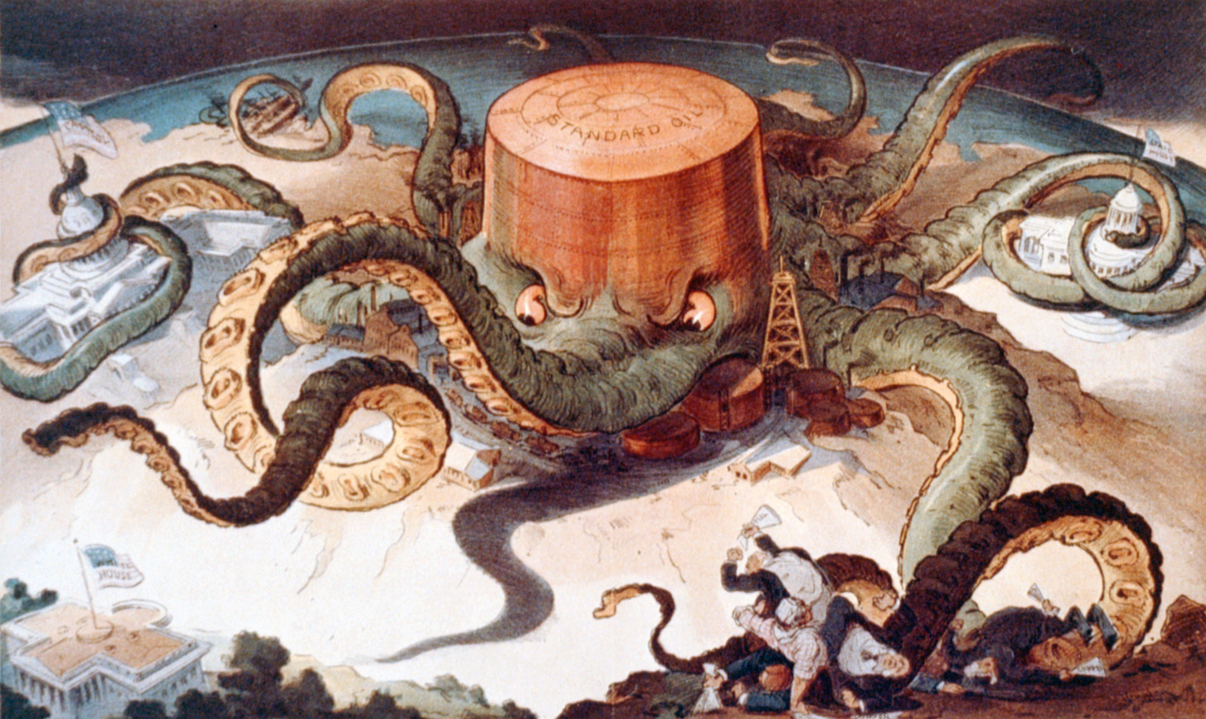
Literary Landmarks
Realism – sought to document contemporary life and society as it really was, in all its raw and raucous and sometimes even scandalous detail
William Dean Howells, Atlantic Monthly, The Rise of Silas Laphan
Mark Twain (Sam Clemens), Huck Finn and Tom Sawyer
Naturalism – examined the determinative influence of heredity and social environments in shaping human culture
Edith Wharton, Stephen Crane, Jack London
Frank Norris, The Octopus
Regionalism – aspired to capture the peculiarity, or “local color,” of a particular region, before national standardization bleached its variety away
Stories of the Gold Rush, black dialect and folklore, feminism, and other chaotic forces of turn-of-the-century life

Slide 16
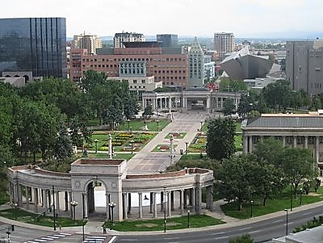
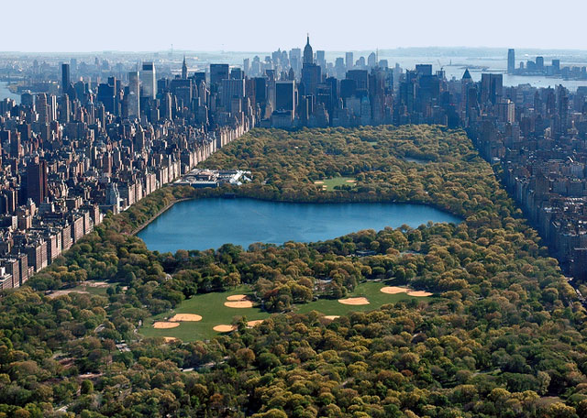
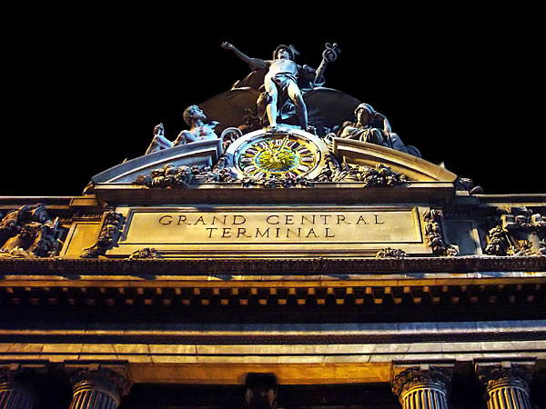
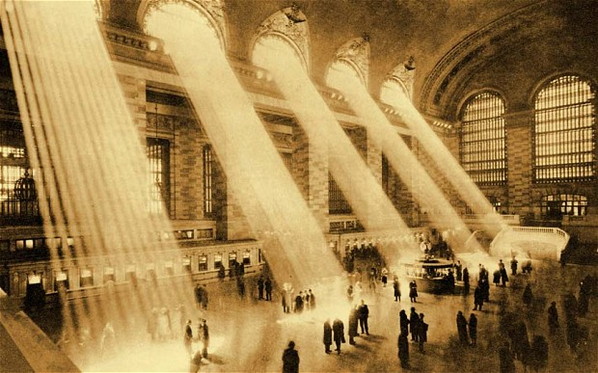
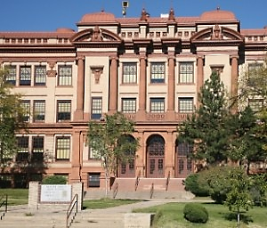
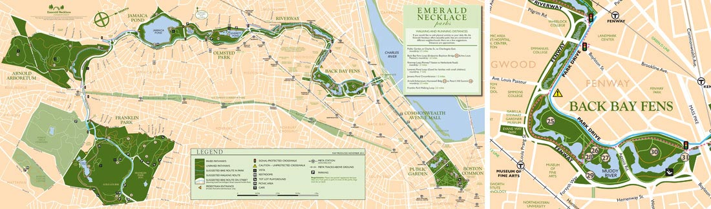
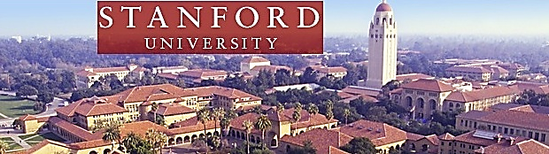
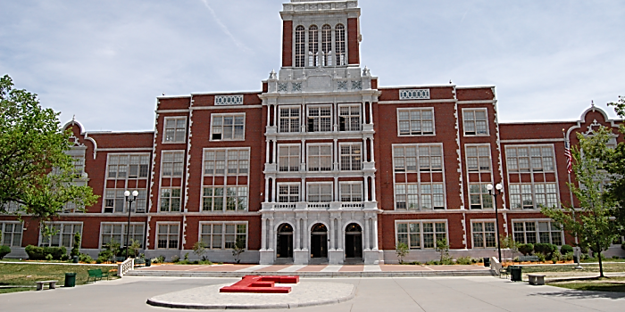
Artistic Triumphs
City Beautiful movement
Convey a sense of harmony, order, and monumentality
Copied European styles od classicism and planning ideas of
Frederick Law Olmsted

Slide 17
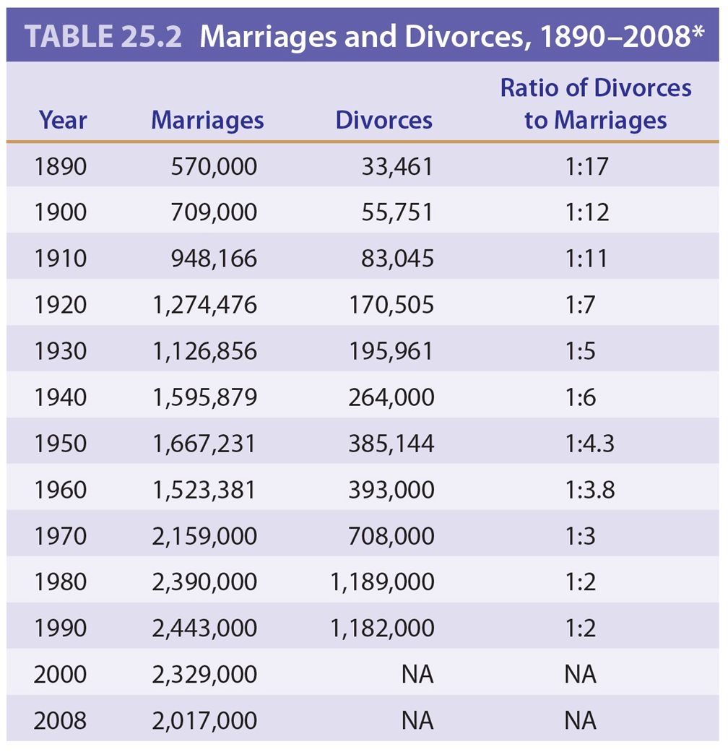
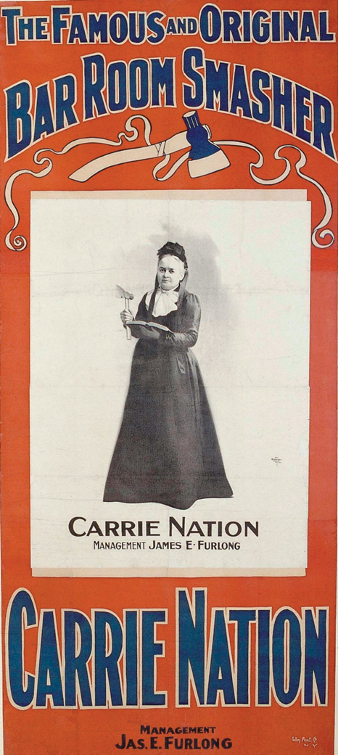
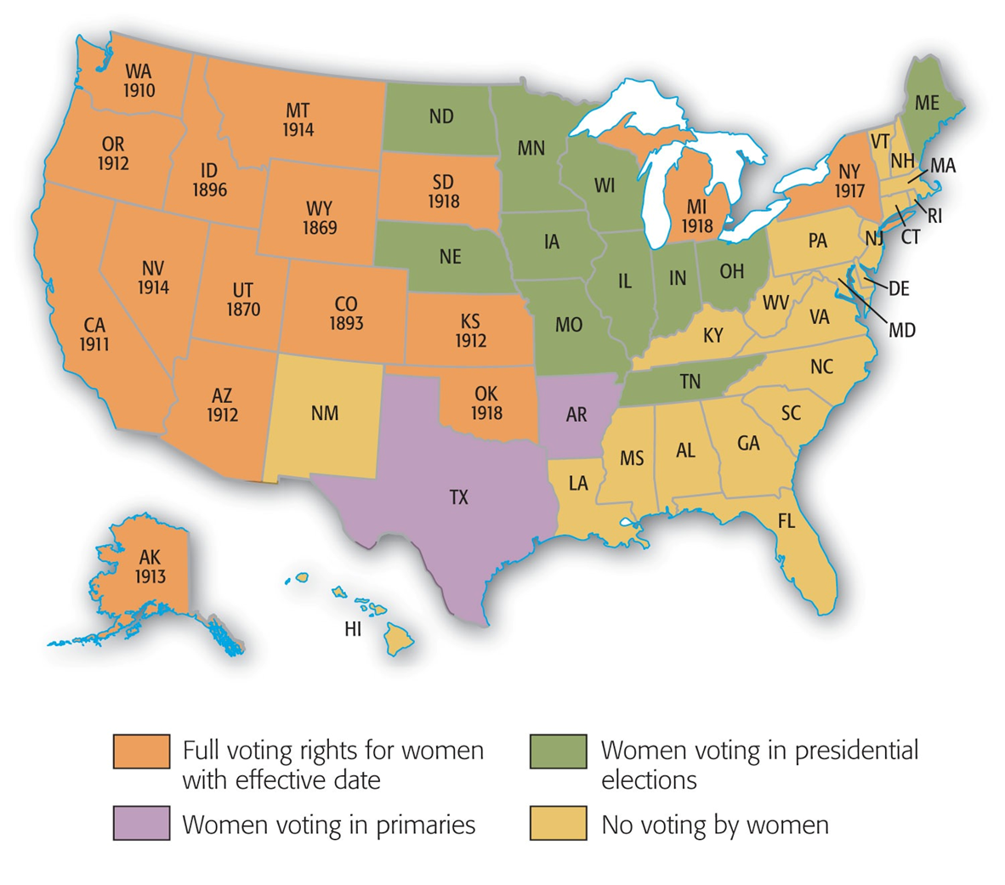
Families, Women, & Reform
The urban era launches divorce era
More children = more mouths to feed
Birthrates drop, family size shrinks, and marriages delayed
Charlotte Perkins Gilman
Women and Economics, called on women to abandon their dependent status and contribute to the larger life of the community through productive involvement in the economy
National American Women Suffrage Association (NAWSA)
Elizabeth Cady Stanton and Susan B. Anthony
Carrie Chapman Catt: votes ≠ rural and city life
Temperance reformers
“the poor man’s club” – nerve racking Civil War days and immigrants increase alcohol sales
Woman’s Christian Temperance Union (WCTU)
National Prohibition (Eighteenth) Amendment
Temporary relief

Slide 18
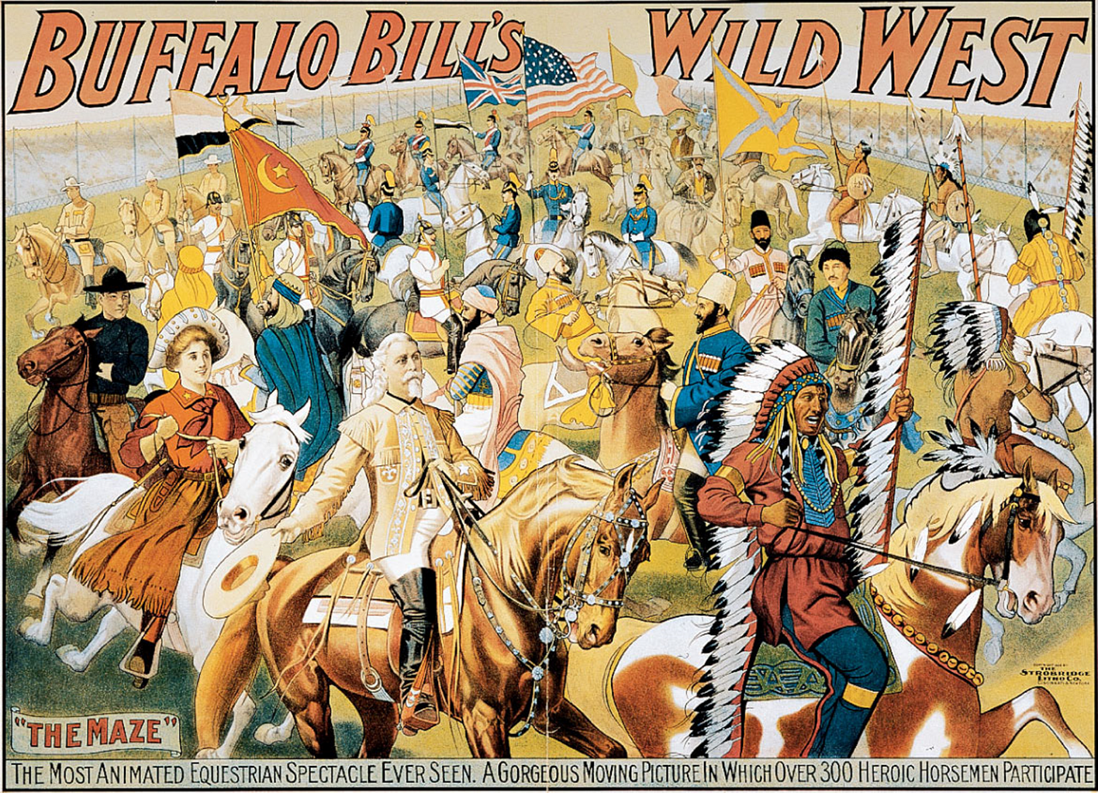
The Business of Amusement
P. Barnum and J. Bailey – “The Greatest Show on Earth”
“Buffalo Bill” and Annie Oakley
Baseball emerging as national pastime, if not a national mania
Dr. James Naismith (basketball) - 1891
Walter Camp (football) – “All America” team
Yale-Princeton game of 1893 drew 50K fans!
Pugilism (aka boxing)
Croquet – “naughty nineties” for exposing women’s ankles
Bicycles – “spinning wheel” offers freedom, not tedium

Slide 19

That’s it!
Subscribe to APUSHReview.com
Help spread the word!
Questions? Comments? Ideas for videos?
Email or leave in comments
Subscribing to this channel equals WINNING!

